Slide 1
Deployment Container Patterns for K8s
Roger Carhuatocto
Version 1.1

Slide 2
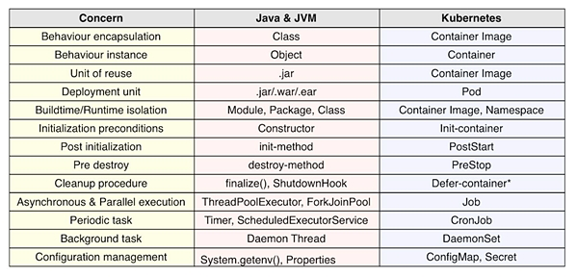
1. The Kubernetes effect
Just as Java brought a new way of doing things in the world of Object Oriented Programming (OOP), Kubernetes has a big effect on the way as The Container-based Distributed Systems are designed and implemented.

Slide 3
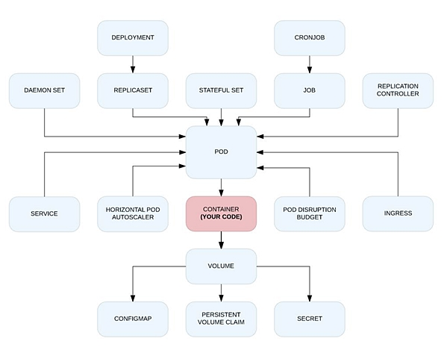

2. A new set of Primitives
1

Slide 4
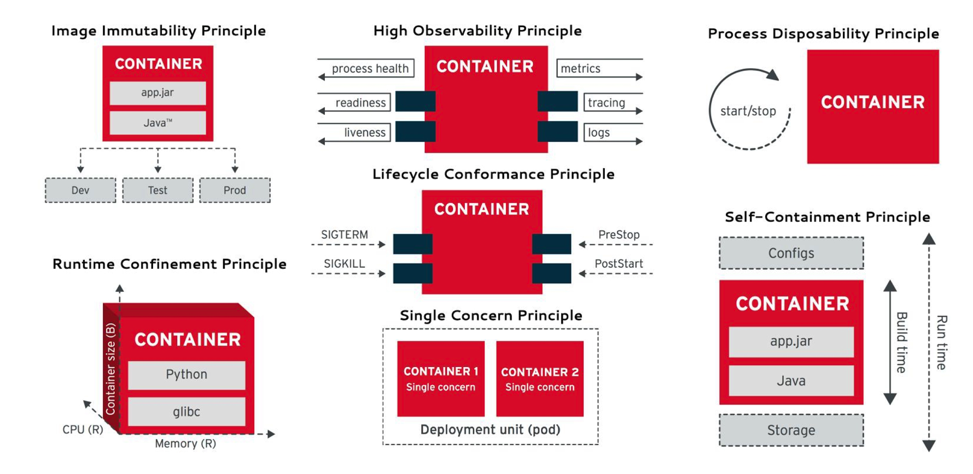
3. Our Principles
2

Slide 5
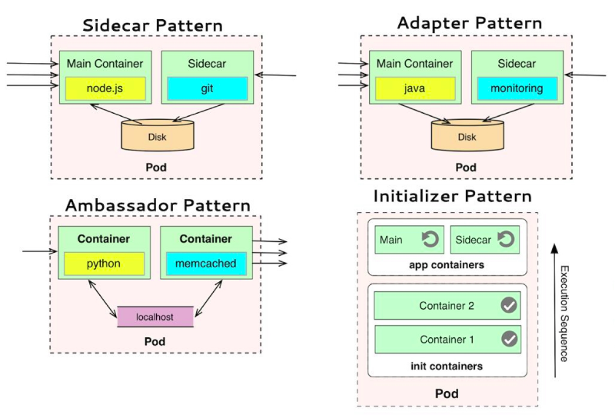
4. The Patterns
3
Pod (*) is the basic “building block” in K8s.
It is the smallest unit of deployment and a running process on the cluster.
Design the Pod Chassis (Single unit of “service” might contain one or multiple App Containers).
Start with one Sidecar.
It will work as Ambassador, Adapter and Init sometimes.
It meets the Separation of Duties (Security Principle).
Bootstrap and initialize operational tasks with Init Container.
Pod
Init
Container
Sidecar Container
Application
Container
Application
Container
Application
Container
(*)https://kubernetes.io/docs/concepts/workloads/pods/pod-overview/

Slide 6
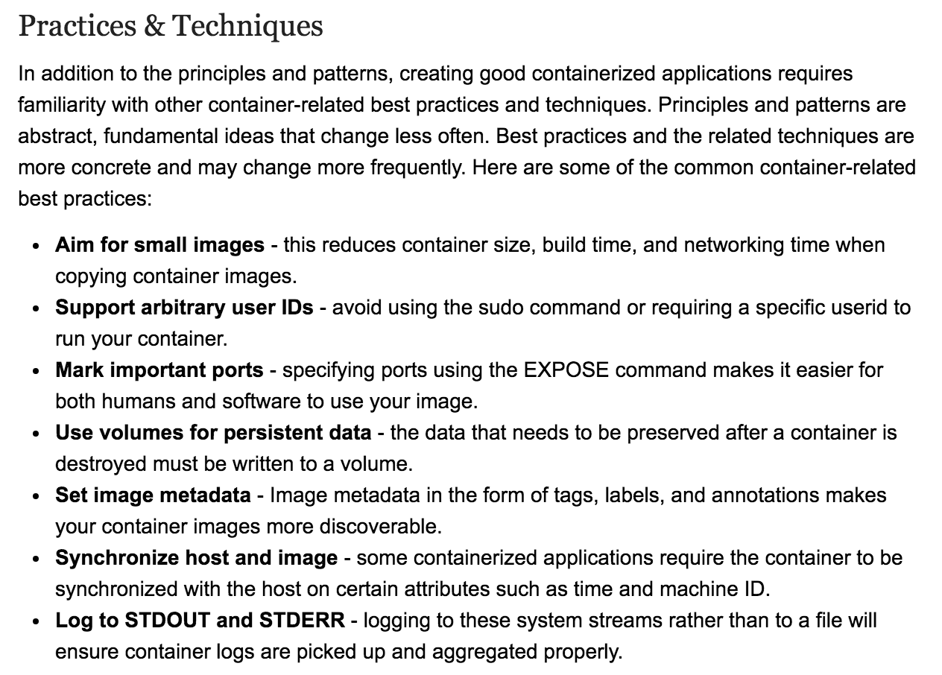
5. The Best Practices
4

Slide 7
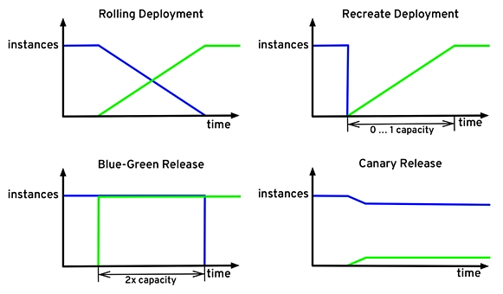
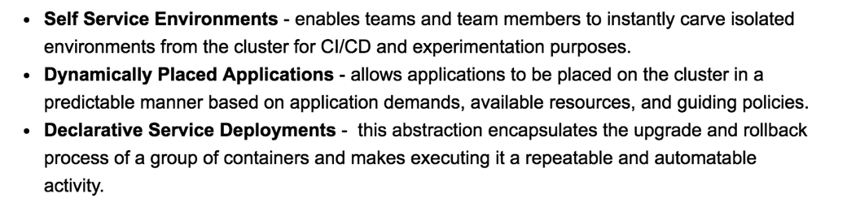
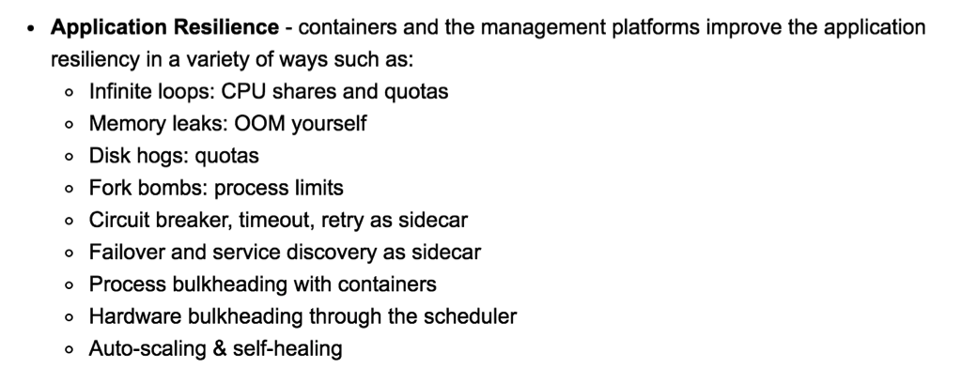
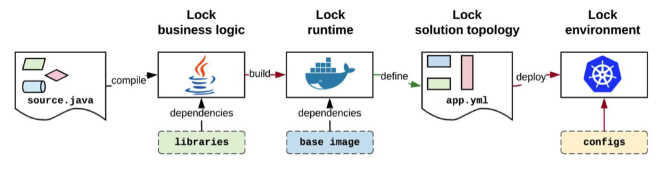
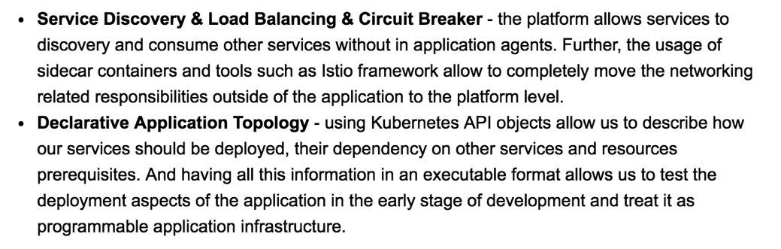
6. The Benefits
5

Slide 8
7. References
Design patterns for container-based distributed systems
By Brendan Burns David Oppenheimer - Google
https://static.googleusercontent.com/media/research.google.com/en//pubs/archive/45406.pdf
The Kubernetes Effect.
By Bilgin Ibryam, Principal Architect, Red Hat
https://www.infoq.com/articles/kubernetes-effect
The Twelve Factors
https://12factor.net
The OWASP Security by Design Principles
https://www.owasp.org/index.php/Security_by_Design_Principles
Microsoft - Cloud Design Patterns
https://docs.microsoft.com/en-us/azure/architecture/patterns

Slide 9
8. Use cases: TBC
Log Aggregation and Log Sanitization
Identity for each Service/API/Microservice (100% traceability = Observability)
End-to-end Security Traffic Protection:
TLS and Mutual TLS Authentication
Bootstrapping X.509 Cert and Lifecycle Management
L7 Segmentation
Service Registry and Service Discovery
Fine-grained Traffic Management
A/B Testing, Canary Deployment.
….TBC

